Slide 1



Practice
Collecting Multiple URL Review Data
Digital Business Ecosystem Research Center

Slide 2
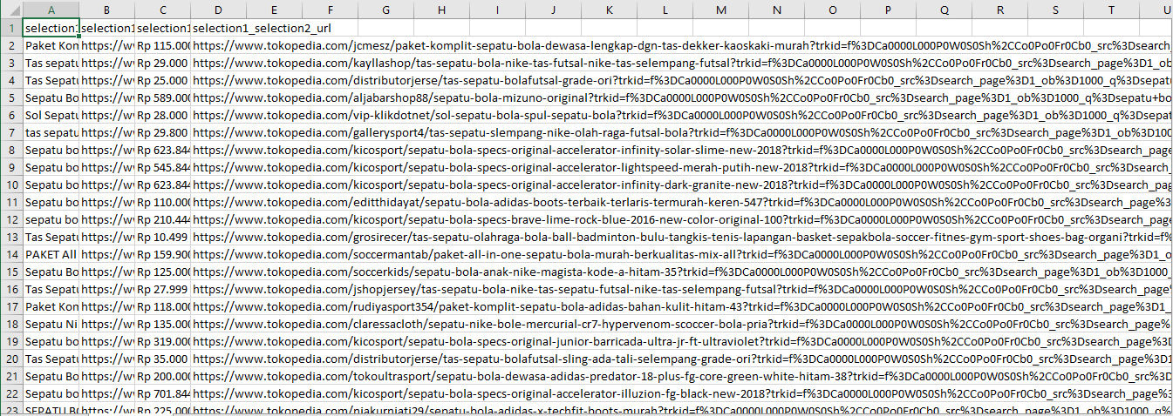
Make sure you have scraping data on product names, prices, and urls on the webpage.

Slide 3
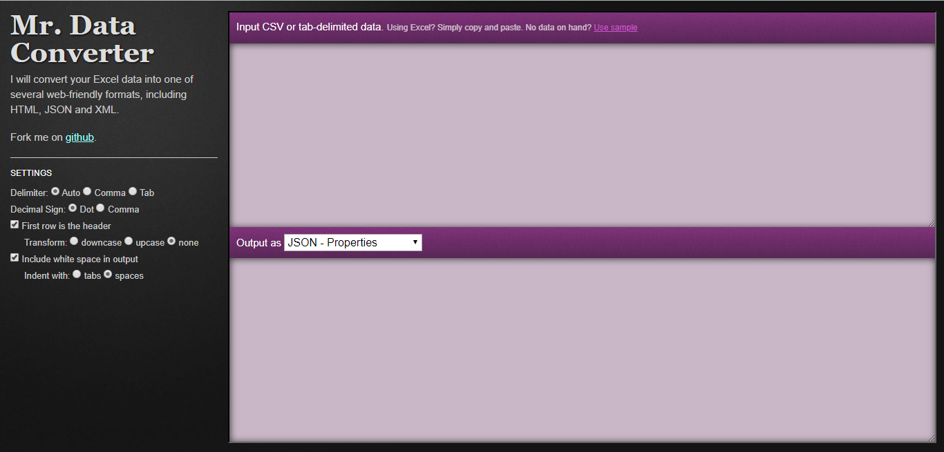
Go to Mr. Data Converter.
https://shancarter.github.io/mr-data-converter/

Slide 4
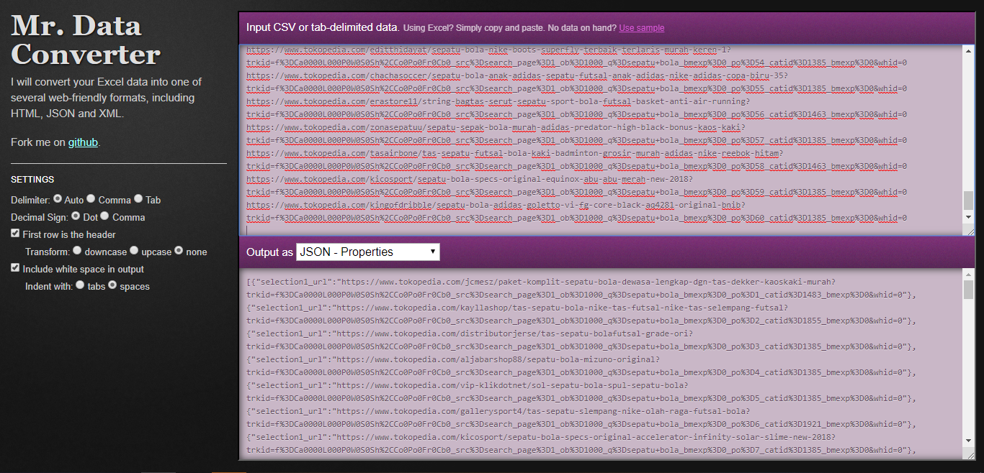
In the first box enter all of your links. Make sure to type in a heading name at the top of the column such as "urls".

Slide 5
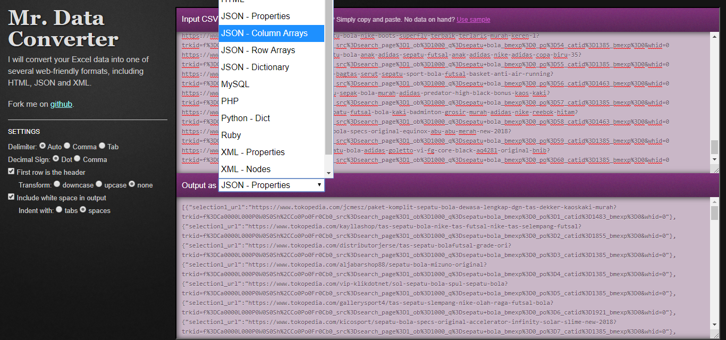
From the dropdown select "JSON - column arrays".

Slide 6
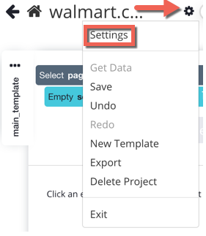
Open your project using any page as the URL, such as the homepage for your website.
Go to the "Settings" menu in the project.

Slide 7
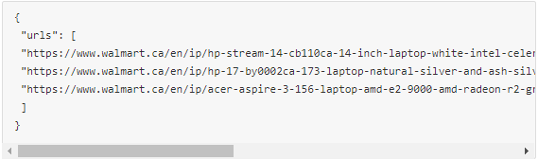
Paste JSON from Mr. Data Converter into the "Starting Value" textbox, you can format it as follows:
The list name "urls" can be renamed to anything you want such as "links" or something more descriptive like "shoes" or "brands".
You can enter as many links in the structure as you want. We have 3 in the example below, but you can keep adding more links inside quotation marks and separated by a comma.

Slide 8
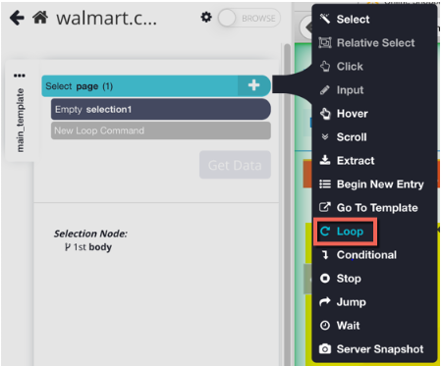
Click on "Back to commands" to go back to the project view.
Click on the + button on the right side of the "Select page" command.
From the tool box, choose the "Loop" tool. It is inside "Advanced". The loop tool iterates over a list. It is good for repeating commands multiple times.

Slide 9
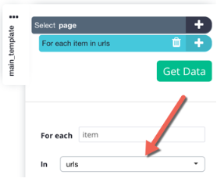
When added, your Loop command should default to looping through your "urls" list.

Slide 10
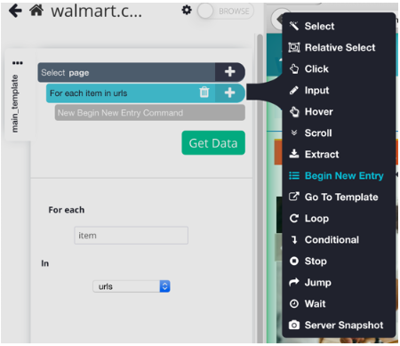
Click on the + button on the right side of the "For each item in urls" command.
From the tool box choose the "Begin New Entry" tool. Now the results of each one of the urls will go into a separate row in CSV and a separate object in JSON.

Slide 11
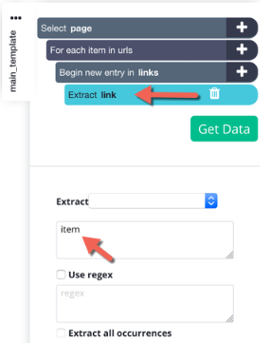
Rename the "list1" command to something else like "links". Make sure not to name the Begin new entry command the same as the list that holds your urls.
The begin new entry command should have a unique name.

Slide 12
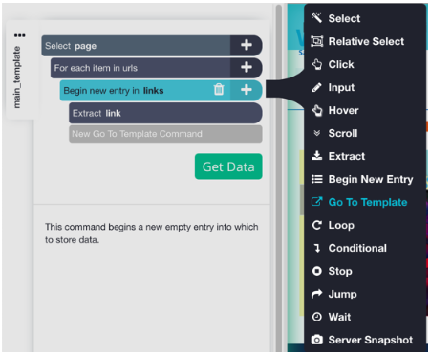
Click on the + button on the right side of the "links" command and choose the "Go To Template" command from the tool box. The Go To Template command will let you specify which url you want to go to and which type of page you want to open.

Slide 13
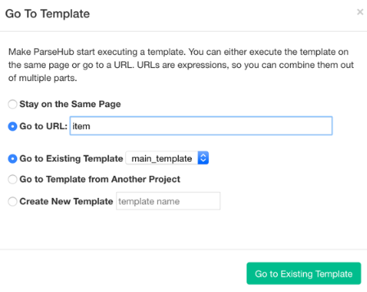
On the pop up window, choose the "Go to URL" option instead of the "Stay on the Same Page" option.
In the text box type in "item" without quotation marks, assuming you didn't name it something else.

Slide 14
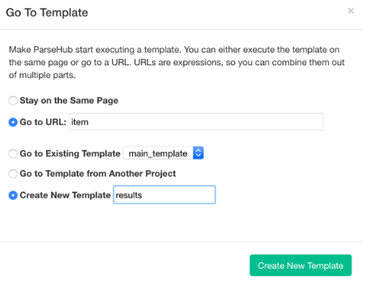
In the "Create New Template" text box type in the name of a new template you want to open for each link - such as "results".
Click on "Create New Template". You should now be taken to the first url in your JSON list and a new template should be created for you.

Slide 15
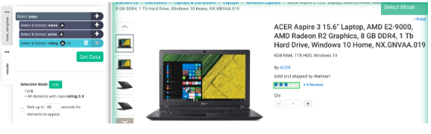
On this new template continue making commands that will be applied to each of the urls in your list in turn.

Slide 16
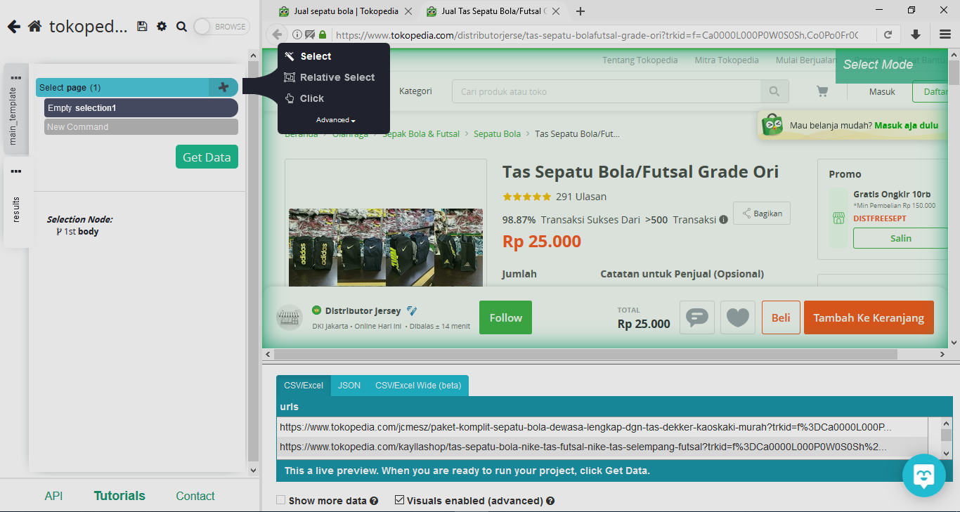
Click on the + button on the right side of the “select page (1)" command.

Slide 17
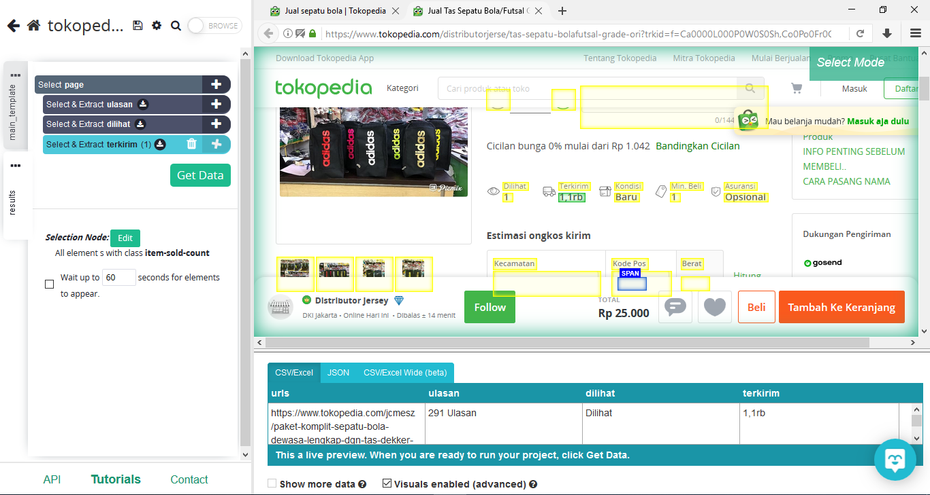
Select the data you want to retrieve and this time the number of reviews, the number of views, and the number sent. After that click “Get Data”.

Slide 18
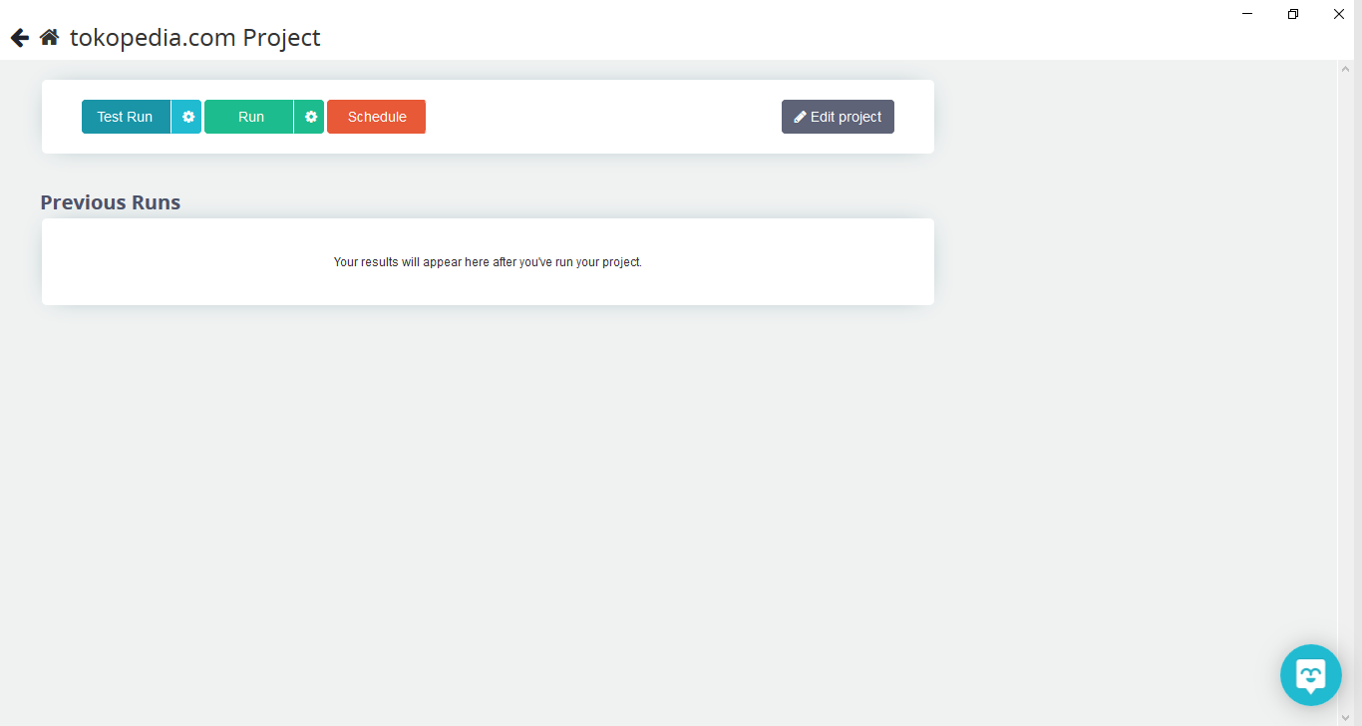
Click “Run”

Slide 19
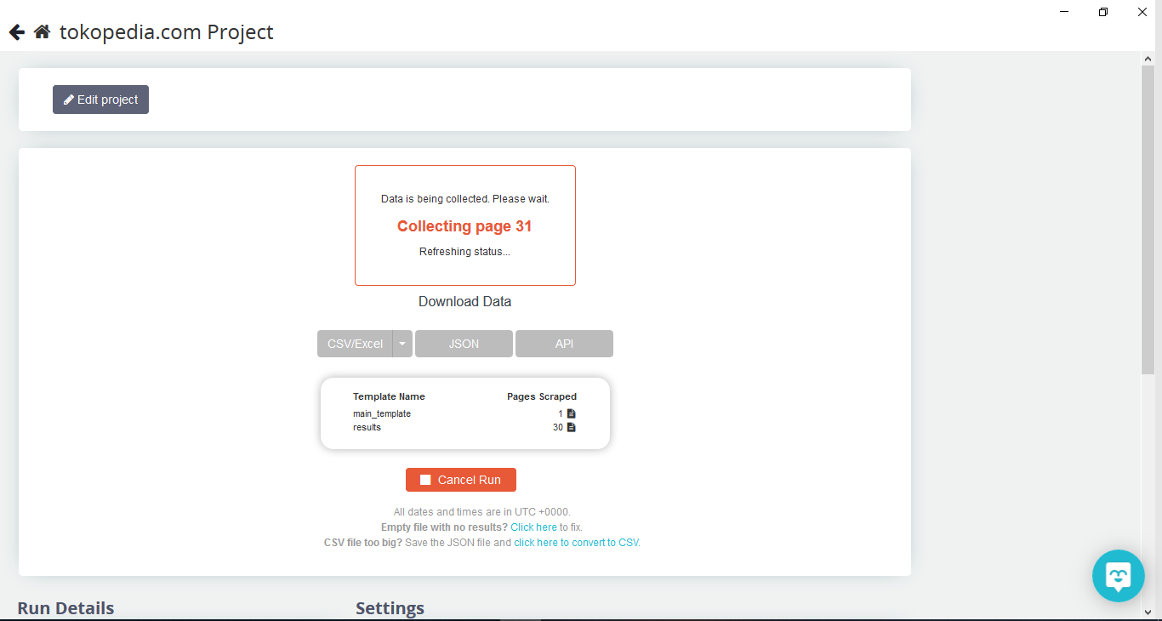
Please wait for a while until the data is ready to be downloaded

Slide 20
Please wait for a while until the data is ready to be downloaded

Slide 21
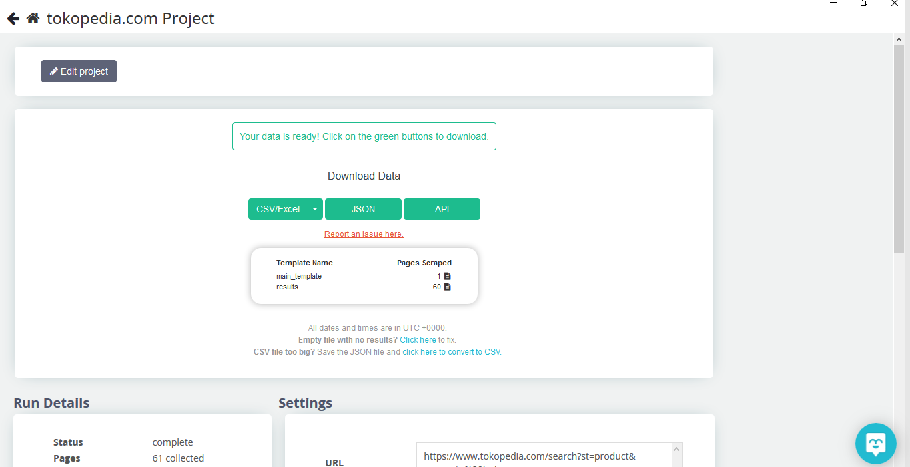
Please download data according to data type requirements.

Slide 22

THANK YOU

